Slide 1

Python Fundamentals
Course Introduction
SoftUni Team
Technical Trainers
Software University
https://softuni.bg/

Slide 2
Table of Contents
Course Objectives
Training and Team
Course Organization
  Course Infrastructure
  Evaluation Criteria
2

Slide 3
Have a Question?
sli.do
#fund-python

Slide 4











SoftUni Diamond Partners
4

Slide 5



Educational Partners

Slide 6

Course Objectives

Slide 7
Python Fundamentals Objectives
Working with linear data structures
  Lists
Defining functions and simple classes
Working with objects
Processing and manipulating strings
Regular expressions
7

Slide 8
Practical Programming Exam
Mid Exam – 4 hours
  3 practical problems
    Conditional Statements and Loops
    Linear Data Structures – Lists
Final Exam – 4 hours
  3 practical problems
    Dictionaries
    Strings and Text Processing
    Regular Expressions
8

Slide 9
Theoretical Exam
You will have 30 minutes once you enter
  Multiple-choice with 1 correct answer
  Test will be in English
Automated quiz system
Available online on the day of the practical exam
  You can submit your answers just one time
9

Slide 10

The Team

Slide 11
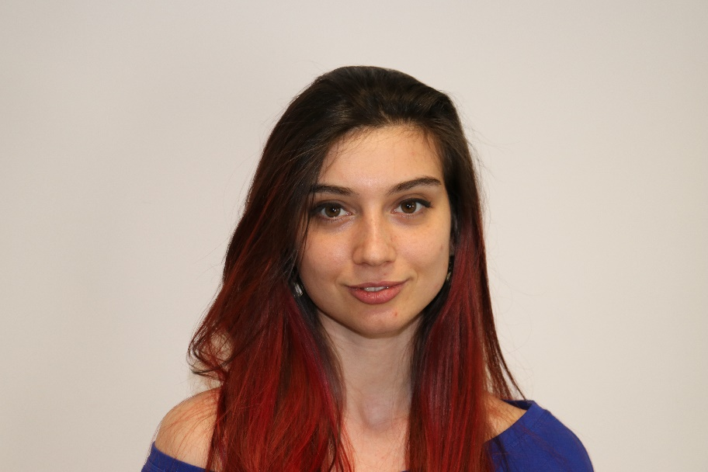
Ines Ivanova
    Python Software Engineer at IQVIA
    Full stack freelance developer
    Python, Django
    C#, Angular
    HTML, CSS
    jQuery, Flask, Docker

Slide 12
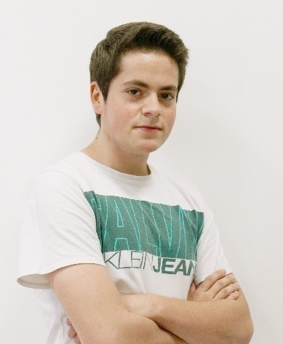
Kristiyan Ivanov
    Top Student @ SoftUni
    Technical Trainer @ SoftUni
    Student @ Technical University of Sofia
    Interests include mechanics and electronics
    Automotive Software Development
    Interested in coding with C#, Python, C++

Slide 13

Course Organization

Slide 14
Python Fundamentals Module
17-May-2021
10-Jul-2021
14-Aug-2021
17-Aug-2021
20-Aug-2021
Python Fundamentals
12 weeks * 3 times / week
12 credits
Start: 17-May-2021
Mid Exam: 10-Jul-2021
Theoretical Exam: 14-Aug-2021
Final Еxam: 14-Aug-2021
Re-Take Exams
Mid Exam Retake: 17-Aug-2021
Theoretical Exam Retake: 20-Aug-2021
Final Exam Retake: 20-Aug-2021

Slide 15

Homework Assignments & Exercises
Your homework is mainly work in class
  Lesson days → slides + live demos + exercises
  Exercise days → only exercises
How to submit your homework?
  Submitted in the judge system
Do your homework when it's due
  Assignments pile up quickly

Slide 16


SoftUni Certificate
Practical
Exam
100%
Homework
5%
Evaluation
16

Slide 17
CPE Certificate
Practical
Exam
Theoretical
Exam
Evaluation
17

Slide 18


Course Web Site, Forum and FB Group
Official web site:
Softuni Python Community group:
https://softuni.bg/courses/programming-fundamentals-csharp-java-js-python
https://www.facebook.com/groups/SoftUniPythonCommunity

Slide 19
Questions?
Notes:
19

Slide 20
Trainings @ Software University (SoftUni)
Software University – High-Quality Education, Profession and Job for Software Developers
  softuni.bg, softuni.org
Software University Foundation
  softuni.foundation
Software University @ Facebook
  facebook.com/SoftwareUniversity
Software University Forums
  forum.softuni.bg
20
Notes:
20

Slide 21

License
This course (slides, examples, demos, exercises, homework, documents, videos and other assets) is copyrighted content
Unauthorized copy, reproduction or use is illegal
© SoftUni – https://softuni.org
© Software University – https://softuni.bg
Notes:
21

